Slide 1
1. Teacher Instructions
Title: The Western Treatment Plant
Length: Approximately 2 x 60 minute lessons + homework task (survey)
Description: In this session, the inquiry question and end products are revealed, students then need to identify the information they need to respond to the inquiry question; and will then gather information from Melbourne Water and other sources.
Inquiry question; ‘How can the Western Treatment Plant help Melbourne to thrive and adapt to an uncertain future?’ In groups, students discuss the question and complete the first two columns of a ‘Know, Find Out, Learnt’ chart (KFL).
Using the suggested resources from Melbourne Water, including the Western Treatment Plant Virtual Tour, groups of students find the information they need to respond to the inquiry question.
The groups prepare and conduce a survey to collect their own primary data
Overview:
Identify what they know and what they need to find out to respond to the inquiry question
Gather information and data from primary and secondary sources
Produce a concept map to visualise research findings
***See Notes on each slide for more teaching notes and ideas***

Slide 2
Instructions
The following is a suggested sequence of activities and time allocation. You might want to spend more or less time on specific sections depending on your class and their learning requirements. All resources can be edited to suit your teaching needs.
Slide | Description | Time
1.1: Inquiry question | Introduce the topic - How can the Western Treatment Plant help Melbourne to thrive and adapt to an uncertain future? And students complete a KFL chart | 10 mins
1.2: Sewage treatment | How is sewage treated and recycled water produced | 10 mins
1:3: Recycled water | Learn about recycled water | 10 mins
1.4: Survey | Primary data collection and find out what Melbournians think about recycled water. | 10 mins
1.5: Survey | Components and an outline and instructions to conduct the survey | 10 mins
1.6: Survey | Details about primary data collection
1.7: What did I find out
1.9: Rubric: Survey |  | n/a
1.10: Rubric: Hexagon concept map |  | n/a

Slide 3
Western Treatment Plan
How can the Western Treatment Plant help Melbourne to thrive and adapt to an uncertain future?

Slide 4
Learning outcomes
Describe how water is a renewable natural resource that is finite
Identify the different factors that contribute to water variability and the impacts of water scarcity
Explain the different methods to overcoming water scarcity, by reducing demand and increasing the supply of water
Understand that Melbourne's water resources will be impacted by climate change
Know that the liveability of Melbourne depends on a safe and secure supply of water and treatment of wastewater

Slide 5
1.1: Inquiry question
How can the Western Treatment Plant help Melbourne to thrive and adapt to an uncertain future?
What do I know about sewage, recycled wastewater and the Western Treatment Plant? | What do I need to find out? | What have I learnt?
Notes:
Teaching notes & ideas

Slide 6
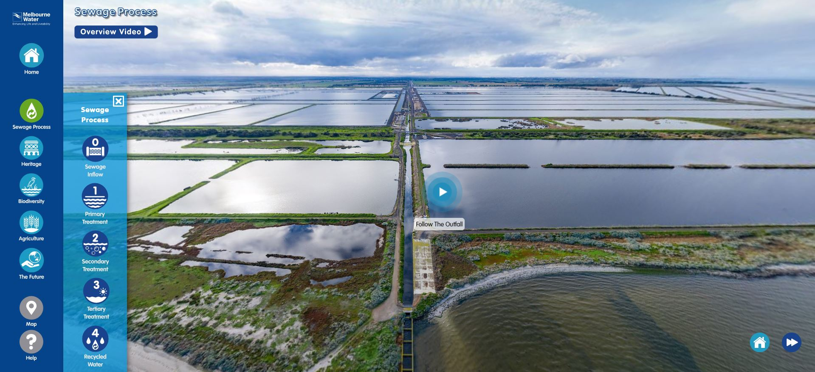
1.2: Sewage treatment
Take a virtual tour of the Western Treatment Plant and follow the Sewage Process
Fill out the KFL Chart.
Notes:
Teacher notes & ideas

Slide 7
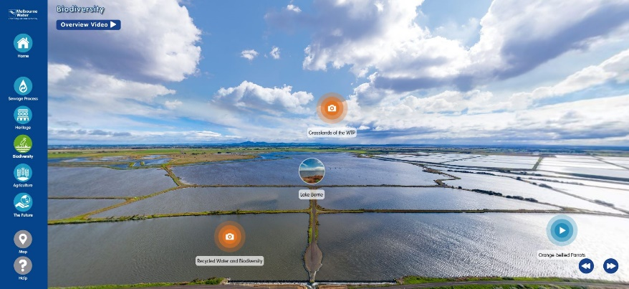
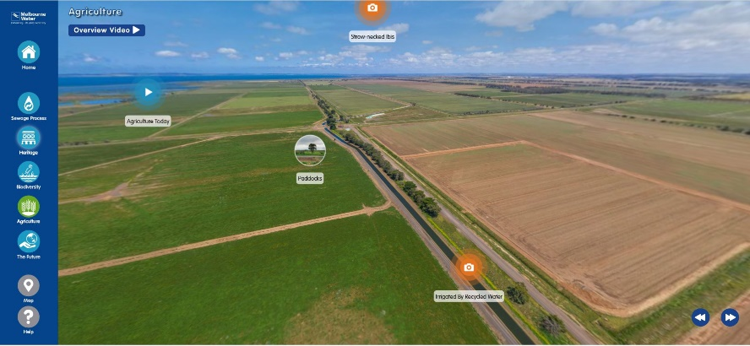
1.3 Recycled water
Take a virtual tour of the Western Treatment Plant and check out ‘Agriculture’ and ‘Biodiversity’.
Watch the overview videos and tour the locations.
Fill out the KFL Chart.
Notes:
Teacher notes & ideas

Slide 8
1.4: Survey & primary data collection
Find out what Melbournians think about recycled water.
As a group, design and conduct a survey of friends or family. Find out what people in Melbourne think and know about recycled water and the Western Treatment Plant.
This data will help you to investigate and respond to the inquiry question:
How can the Western Treatment Plant help Melbourne to thrive and adapt to an uncertain future?
Notes:
Teacher notes & ideas

Slide 9
1.5 Components of the survey
Statement | Agree | Disagree
Water conservation is important.
I try to limit the length of my showers.
Recycled wastewater can be made safe to drink.
Components of the task
Survey friends and family using Google Forms, MS Forms or similar apps. Aim for a minimum of 10 survey questions and try to find at least 10 people for your group to survey. Try and make the questions clear and interesting and easy to answer.
Present results by graphing the results to each question. Don’t forget to include a specific and informative label or title for each graph. Any symbols or colours need to be explained in a key.
Analyse results. Discuss the most significant trends or findings from the data. Use specific examples to support your analysis. Describe any unexpected or interesting results. Aim for 1-3 paragraphs for the analysis section.
It will be easier to gather data if you limit the possible responses. One of the simplest ways to conduct a survey, is to provide respondents with a statement that they can agree or disagree.
Notes:
Teaching notes & ideas
Xxxx

Slide 10
1.6: Primary data collection
Are the people you survey apprehensive or confident about the use of recycled water?
Do they know what happens at the Western Treatment Plant or where their waste goes after they flush the toilet?
You can use MS Forms or Google Forms to create the survey. These applications will automatically graph the data from your responses.
Notes:
Teacher notes & ideas

Slide 11
1.7: What did I find out
Task: In groups, students produce a hexagon concept map to demonstrate what they have found out about the inquiry question:
How can the Western Treatment Plant help Melbourne to thrive and adapt to an uncertain future?
For more information on using Hexagonal planning see Learning activities
The diagram should show links between inputs, processes and outcomes but also link to impacts and stakeholders.
Notes:
Teaching notes & ideas
Groups receive a sheet of hexagonal tiles for each person in the group, or a file with a digital template, and a large sheet of paper to stick the tiles to. Students fill each tile with a keyword, fact or statement and decide how to arrange the tiles to build a web of connections. Each hexagon can connect to up to six others and students should keep rearranging until they feel they’ve created the strongest web of connected ideas.
Use the link in the slide for more information and templates to print up.

Slide 12
Rubric: Survey
Criteria for Assessment | Excelling 5 | Proficient 4 | Consolidating 3 | Developing 2 | Beginning 0-1
Use of technology | By the end of the task, everyone in the group can use the recommended app to collaborate, collect and present data. The group is able to support each other to become confident with the technology. | By the end of the task, everyone in the group can use a form of technology to collaborate and collect data. | Technology is used by some members of the group to complete the task. The group finishes the task with different levels of confidence. | The group is able to use some features to collect data. Technology skills are still developing and the group would benefit from more assistance, practice and exploration. | Data collection is not shown or is incomplete. There is limited use of technology or technology is not used and the task is completed with pen and paper.
Survey | There are 10 or more clear survey questions that relate to the inquiry question. 20 or more people have been surveyed by the group. | There are 10 or more clear survey questions that relate to the inquiry question. 10 or more people have been surveyed by the group. | There are 10 or more survey questions that relate to the inquiry question. Some questions may be too complicated or lack clarity or relevance. 10 or more people have been surveyed by the group. | There are fewer than 10 survey questions that relate to the inquiry question. Questions may be complicated, unclear or lack relevance. A limited number of people have been surveyed. | There are insufficient survey questions and/or they are unclear or lack relevance. Too few people have been surveyed.
Presentation of data | Graphs have a descriptive title/ label. All graphs have a key. The most appropriate style of graph or table has been selected. | Graphs have a title/label. All graphs have a key. An appropriate style of graph or table has been selected. | Graphs or tables have a key and a general title/label. These could be more descriptive. Sometimes the choice of graph is not appropriate for the data. | An attempt has been made to present some data using graphs or tables. Labels/ titles and keys are missing or too general. The choice of graph is not always appropriate for the data. | The data has not been graphed or only some of the data has been graphed. Labels/ titles or keys are missing.
Analysis of data | The analysis explains significant, interesting and unexpected trends in the data. Specific examples from the data are always used to support the analysis and provide evidence. | The analysis describes the key trends in the data. Some specific examples from the data are used to support the analysis and provide evidence. | The analysis describes some of the trends from the data. The analysis is usually not supported with a specific example from the data. | The data is described in a general way. Some significant trends are not discussed. Specific data is not used to support the analysis. | The analysis is general and limited. Examples from the data are not given.
Notes:
Teaching notes & ideas
Use this Rubric to assess students’ surveys

Slide 13
Rubric: Hexagonal concept map
Criteria for Assessment | Excelling 5 | Proficient 4 | Consolidating 3 | Developing 2 | Beginning 0-1
Understanding of processes, concepts and key vocabulary. | The group can demonstrate a deep and broad understanding of several processes, concepts and key vocabulary. They make lots of insightful and novel connections between ideas. | The group can demonstrate a good understanding of several processes, concepts and key vocabulary. They make relevant connections between ideas | The group can demonstrate understanding of several processes, concepts and key vocabulary. They can link some ideas. | The group can demonstrate understanding of some processes, concepts or vocabulary. Links between ideas are not always clear or logical. | The group is unsure about the process, concepts or vocabulary or how ideas link together.
Construction, design and detail. | The presentation of the concept map is clear. Ideas are legible and appropriately detailed. | The presentation of the concept map is clear. Ideas are legible. | The presentation of the concept map is clear. Ideas are mostly legible. | More care needs to be taken with presentation and execution. Concepts could be neater or more detailed. | The presentation of ideas is not clear. Concepts could be neater or more detailed.
Group work | The whole group contributed in different ways and negotiated in a constructive manner. Each member listened and engaged with the task. | The group did their best to negotiate and compromise. Members listened to each other and engaged with the task. | The group usually tried to negotiate and compromise. Most of the time the group could demonstrate engagement through listening and participation. | The group encountered some challenges which could be addressed by being more prepared to listen, participate and compromise. | Group members could not, or did not contribute in a constructive manner. The effectiveness of the group could be enhanced with more listening and participation.
Notes:
Teaching notes & ideas
Use this Rubric to assess students’ concept maps

Slide 14
Curriculum links
Geographical Knowledge: VC2HG8K03, VC2HG8K04
Geographical Skills: VC2HG8S02, VC2HG8S03, VC2HG8S04, VC2HG8S05, VC2HG8S06
Science: VC2S8H03, VC2S8U09

